Slide 1
25-26 Quality Objectives - Update
Presented By: Brian Smith, VP Clinical Services/CHRO
Presented To: Board Quality

Slide 2
Excellent Experience:
Strategic Theme: Excellent Experience | Owners | Objective | Outcome | Measure | Target | Actual | Q1 | Q2 | Q3 | Q4
 | H.Mostamandi | Standard work for structured patient rounding | Consistent, structured in patient rounding | EMR Task completion report, pre and post implementation survey | 75% | SLT To start Late October/Mid November, scripts and log sheets created, policy work | On target | On target | On target
 | C. Menard | Patient Whiteboards | Roll out of patient white boards to MS 3rd Floor | Develop and deploy patient white boards to each patient room and surge space on MS 3rd floor | 100% deployment | whiteboards V1 designed. awaiting prototype to trial. Clinical staff to review and provide feedback | On target | On target | On target
 | H. Mostamandi | Wound Care Strategy | Create a Wound Care Champion Team | Recruitment, education, and follow up with 6 wound care champions | 6 Active RN/RPNs who specialize in wound care | 6 RNs and RPNs trained through NSWOCC, Nursing Education Skills Days in November, start competency training for all RPNs to increase scope of practice | On target | On target | On target

Slide 3
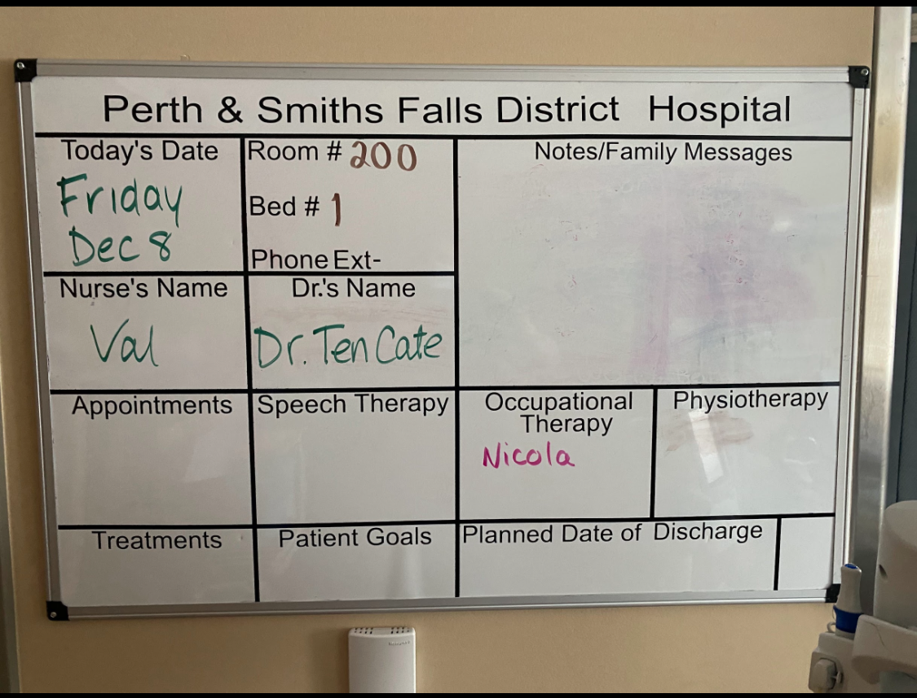
White Board Project:

Slide 4
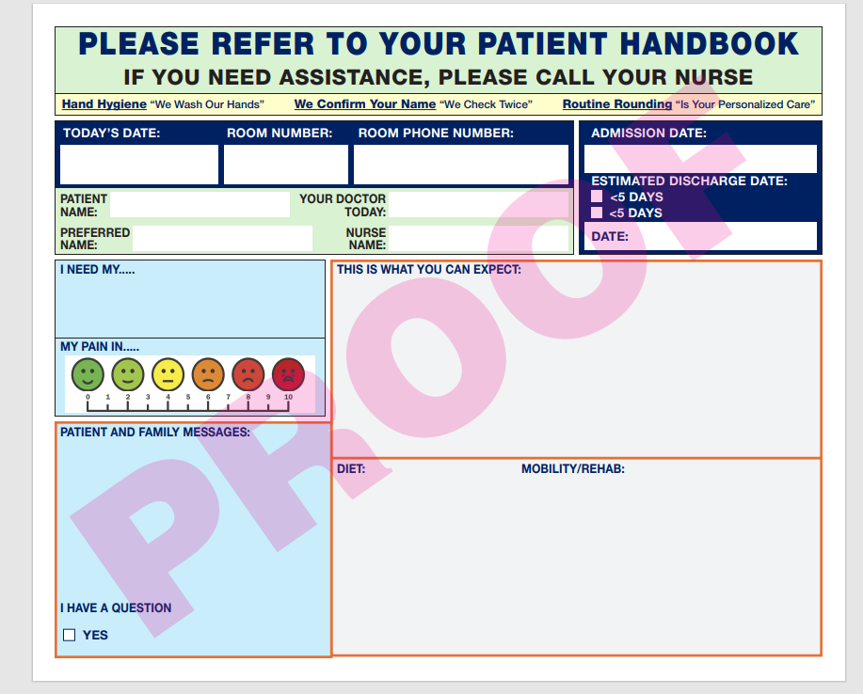
Communication Board Project:
Notes:
DEI, AODA, Accreditation Canada

Slide 5
Ensure our Future Sustainability:
Strategic Theme: Ensure our Future Sustainability | Owners | Objective | Outcome | Measure | Target | Actual | Q1 | Q2 | Q3 | Q4
 |  | Achieve target for first case starts | First cases start on time and are comparable to the provincial average | % of First Case Starts that start on time | 70% |  | 71% | 71% | 72% | ~80%

Slide 6
Where are we at to-date?
OR First Case Start is achieving desirable state and will transition KPI’s to OR Committee
Trialing new Communication Boards in Perth and Smiths Falls – St. Lawrence College students to review and refine

Slide 7
Ongoing
Focus for the leadership team this year is Accreditation Canada site visit in May 2026
Process audits
Mock Tracers
We continue “watching” metrics e.g. falls rate, ALC throughput

Slide 8
Questions?

